Slide 1
Movement Primitive
Diffusion
Learning Gentle Robotic Manipulation
of Deformable Objects
Blaine Swieder
Intelligent Surgical Robotics
Scheikl et al. • IEEE RA-L, 2024
Notes:
The paper I am presenting is Movement Primitive Diffusion by Paul Maria Scheikl and colleagues. It appeared in IEEE Robotics and Automation Letters in 2024. The problem is learning robot motions for deformable objects while keeping those motions gentle and using a limited number of demonstrations. I will first explain the motivation and the representation, then walk through the method and the experiments. The final part is a discussion of what the results establish, the limitations, and how the paper fits with the material we have read in this course.
Sources and figure credits
https://arxiv.org/pdf/2312.10008v2 (title and abstract).
DOI: 10.1109/LRA.2024.3382529
https://scheiklp.github.io/movement-primitive-diffusion/

Slide 2
Motivation and Course Context
Task success alone leaves out how the robot moves.
Deformable tissue makes abrupt motion a concern.
Human demonstrations contain different valid strategies.
Surgical demonstrations are costly to collect.
Course connection: MPD turns learned behavior into structured robot motion.
Scheikl et al., RA-L 2024
2
Notes:
The question is not finished once the robot reaches the target. In surgery, how the robot moves can matter to the object it is manipulating. A robot may complete a task and still accelerate tissue abruptly or generate an irregular instrument path. At the same time, surgical demonstrations are expensive to collect, and human demonstrations can contain several valid ways to solve the same task. The authors want a policy that handles that variation without giving up motion quality or requiring a very large demonstration dataset. This is why they study success, motion quality, and data efficiency together.
Sources and figure credits
https://arxiv.org/pdf/2312.10008v2 (Introduction).

Slide 3
Overview of Movement Primitive Diffusion
Diffusion represents several possible motion strategies.
ProDMPs structure the generated motion across time.
MPD combines both in one imitation-learning method.
The evaluation covers success, motion quality, and data efficiency.
Scheikl et al., RA-L 2024
3
Notes:
The contribution is the combination of two ideas. Diffusion models can represent a distribution of possible action sequences instead of collapsing the demonstrations to one typical sequence. Movement primitives give the output a continuous structure across time. MPD puts a Probabilistic Dynamic Movement Primitive, or ProDMP, inside the denoising model. The paper then asks whether that structure improves the quality of the generated motion while retaining the success rates of diffusion-based imitation learning. The evaluation includes four simulated tasks and their corresponding physical bench setups, with both state and image observations.
Sources and figure credits
https://arxiv.org/pdf/2312.10008v2 (Introduction, Sections III-D and IV).

Slide 4
Problem Formulation
o = recent observations τ = future action sequence
Each action contains desired values in a task-specific space.
Demonstrations pair observations with instrument motion.
Training uses shorter windows from complete demonstrations.
A sequence retains temporal context while allowing later adaptation.
Scheikl et al., RA-L 2024
4
Notes:
The model observes recent information and predicts a future action sequence. Each action is a vector in a task-specific space. Depending on the task, this may include grasper articulation, instrument rotation, and translation relative to a remote center of motion. It is useful to distinguish these task-space references from a torque command to an actuator. A demonstration records both observations and actions over a complete task. Training extracts shorter windows from those recordings. The sequence formulation sits between predicting one independent action at a time and committing to one complete motion for the whole procedure.
Notation to say aloud: The lowercase letter o means the recent observation history. It is the input information available to the policy. The paper evaluates task-specific state vectors and RGB images as alternative observation inputs. Tau is the Greek letter τ. Here it means the sequence of future desired actions, not a joint torque. Each τ_i is one action vector in that sequence. In the reported settings, the model uses three observations and predicts twelve actions. In plain language: given what the robot has recently observed, generate a possible next motion segment.
Sources and figure credits
https://arxiv.org/pdf/2312.10008v2 (Section III-A).

Slide 5
Why MPD Uses Diffusion
Several valid strategies can correspond to one observation.
A point-by-point average may create an unsuitable strategy.
Diffusion samples a possible sequence from a learned distribution.
MPD learns to denoise action sequences conditioned on observations.
Scheikl et al., RA-L 2024
5
Notes:
Here, multimodal means several possible behaviors for the same situation. It does not mean video and kinematics as different sensor modalities. As an illustration, two valid demonstrations could travel on different sides of an obstacle. A point-by-point average can produce a route between them, which may be unsuitable. That illustration explains the concern behind mode averaging. It is not an additional experiment from this paper. Diffusion gives the model a way to generate one possible demonstrated strategy, with the initial random sample affecting the selected behavior. The authors want to keep that variation while structuring the motion. In training, Gaussian noise corrupts demonstrated action sequences and an observation-conditioned denoiser learns to recover them. Inference starts from a random sequence and repeatedly refines it. MPD uses the score-based generative framework.
Sources and figure credits
https://arxiv.org/pdf/2312.10008v2 (Introduction and Section III-C). Obstacle example is an illustrative explanation of mode averaging.
https://scheiklp.github.io/movement-primitive-diffusion/ (multimodal behavior).

Slide 6
MPD’s Movement-Primitive Decoder
y(t) = c₁ y₁(t) + c₂ y₂(t) + Φ(t)ᵀ w
ẏ(t) = c₁ ẏ₁(t) + c₂ ẏ₂(t) + Φ̇(t)ᵀ w
w shapes the trajectory through fixed basis functions.
The boundary terms set the starting position and velocity.
The model supports position and velocity along the same motion.
Here, t is time along the generated movement.
Scheikl et al., RA-L 2024
6
Notes:
A movement primitive represents a whole motion segment through a parameter vector and time-dependent basis functions. MPD uses a ProDMP decoder inside its denoiser. These are the position and velocity expressions for one degree of freedom from Equation 1. The first two terms come from the homogeneous solution of the underlying movement-primitive differential equation. The basis-function term contains the learned weights. The weights also incorporate the goal-attractor component described in the paper. Position and velocity use related basis functions rather than two unrelated predictions. The complete policy has several action dimensions, so the decoder applies the construction across those dimensions. The symbol t on this slide is time along the motion trajectory. I will distinguish it from diffusion time in a moment.
Symbol guide: y(t) is the desired value of one controlled degree of freedom along the motion. A dot means its derivative with respect to motion time, so y-dot is velocity. The functions y1 and y2 are the homogeneous solutions. The constants c1 and c2 set the boundary conditions. Capital Phi contains the motion basis functions, and Phi-transpose times w is their weighted contribution. The superscript T means transpose. The vector w contains movement-primitive coefficients generated for this motion segment. These coefficients differ from the trained neural-network parameters theta.
Sources and figure credits
https://arxiv.org/pdf/2312.10008v2 (Equation 1, Section III-B).

Slide 7
Initial Conditions and Continuity
A new segment can start from a specified position and velocity.
Matching both helps connect consecutive reference motions.
The reference construction supplies temporal consistency.
Feedback control still determines how the physical robot follows it.
Scheikl et al., RA-L 2024
7
Notes:
The important guarantee is about the generated reference. The decoder can begin a segment at a specified position and velocity. This is valuable when generating consecutive segments because a new segment can respect the state at its boundary. Position continuity alone would not prevent a sudden velocity change. For the physical robot, a separate issue remains: whether its controller tracks the reference. Calibration error, disturbances, actuator limits, and state-estimation error can still matter. I would therefore keep the mathematical boundary condition separate from a claim that the complete physical interaction is automatically safe or stable.
Sources and figure credits
https://arxiv.org/pdf/2312.10008v2 (Sections III-B and III-D). Physical tracking discussion is presenter interpretation.

Slide 8
MPD’s Probability-Flow ODE
dτ/dt ≈ [τ − Dθ(τ, o, t)] / t
Dθ estimates a denoised sequence under the observation o.
The solver iteratively updates the noisy action sequence.
Diffusion time differs from time along the robot trajectory.
This ODE describes generation, rather than tissue dynamics.
Here, t is diffusion time, tied to the noise level.
Scheikl et al., RA-L 2024
8
Notes:
This is the denoising form in Equation 4 for the paper’s linear noise schedule. The learned function D-theta estimates a denoised sequence conditioned on the observations. The ODE solver changes the noisy sequence as it moves through diffusion time. That time is the noise or generation coordinate, which is different from the future times at which the robot will execute the actions. The paper uses Euler’s method for MPD. The existence of an ODE here does not mean the method has identified a differential equation for the tissue dynamics. This is a generative-model computation that produces a reference sequence.
Read the equation as follows: the rate of change of the candidate action sequence equals the difference between the current sequence and the denoiser output, divided by the diffusion-time variable. D-theta is the learned denoising function, o is the observation history, and theta denotes learned network parameters. The solver follows a schedule from high noise toward low noise. This equation uses the linear schedule sigma(t) = t. The diffusion coordinate t is different from the time at which the robot executes each action. MPD trains the denoiser with denoising score matching. It does not use a measured tissue-state trajectory loss to identify tissue dynamics in the manner of the Silverbox Neural ODE demonstration.
Sources and figure credits
https://arxiv.org/pdf/2312.10008v2 (Equations 2–5 and Section IV-C).

Slide 9
Connection to Neural ODEs
Aspect | Neural ODE (my demo) | Movement Primitive Diffusion
Learned function | State derivative fθ(x, u, t) | Denoiser Dθ with a ProDMP
Integrated quantity | System state x | Noisy action sequence τ
Integration coordinate | Physical system time | Diffusion time / noise level
Purpose | Predict the system response | Generate a future motion reference
The common idea is learning with continuous functions and an ODE solver.
MPD applies that idea to generating a motion sample.
Scheikl et al., RA-L 2024
9
Notes:
This connects to the Neural ODE presentation I gave in AI-Assisted Design. The shared idea is a learned function evaluated within numerical integration. In my Silverbox demonstration, the network represented a state derivative and the solver predicted the response over system time. In MPD, the learned denoiser supplies the information used by a probability-flow ODE to refine a noisy future action sequence. Its integration coordinate is diffusion time, or the noise schedule. The result is a motion reference for the robot. The original Neural ODE paper also studies latent features and continuous network depth, so physical system time describes my dynamic-surrogate example rather than every Neural ODE application. MPD trains its denoiser with score matching. The comparison is a connection between computational ideas, rather than a claim that MPD repeats the earlier paper or learns the physical dynamics of tissue.
Sources and figure credits
https://arxiv.org/pdf/2312.10008v2 (Equations 2–7, Sections III-C and III-D).
https://papers.neurips.cc/paper_files/paper/2018/hash/69386f6bb1dfed68692a24c8686939b9-Abstract.html (Chen et al., Neural Ordinary Differential Equations, NeurIPS 2018).
Blaine Swieder, Neural ODEs: Dynamic Surrogate Modeling, CS 8395-04, slides 2–5 and the Silverbox demonstration.

Slide 10
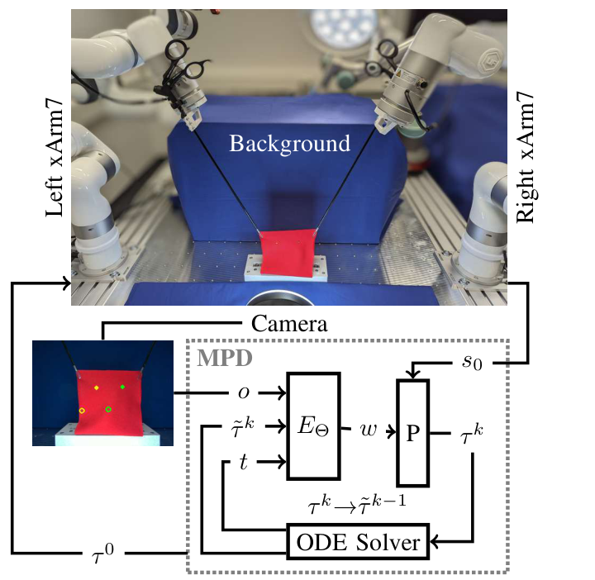
The MPD Architecture
Condition the network on the observation and noisy sequence.
Predict a movement-primitive weight vector.
Decode weights with the initial position and velocity.
Use the ODE solver to continue denoising.
Scheikl et al., RA-L 2024
10
Notes:
The original architecture makes the combination concrete. The network E-theta receives the observation, the noisy action sequence, and the noise level. It predicts a weight vector. The ProDMP decoder P then uses those weights together with the initial position and velocity to produce trajectory values. The probability-flow ODE solver updates the sample and repeats this process. At the final denoising step, the weights can generate the higher-frequency reference used for execution. The ProDMP is inside the denoising computation, so it changes the representation the model learns through, rather than merely smoothing the finished output afterward.
Walk through the symbols in the figure: lowercase o is the observation history. Tau with a tilde and superscript k is the noisy action sequence at denoising iteration k. The variable t gives the diffusion noise level. E-capital-Theta is the trained inner neural network. It predicts w, the coefficients of a movement primitive. P is the ProDMP decoder. It combines w with s-zero, which contains the starting position and velocity, to produce a trajectory. The ODE solver uses the denoising result to update the current sample. Tau-zero labels the final denoised action sequence. Capital Theta and lowercase theta refer to learned network parameters in the authors’ notation. Those stay fixed at inference, whereas w changes with the generated motion.
Sources and figure credits
https://arxiv.org/pdf/2312.10008v2 (Figure 1 and Section III-D). Figure reproduced intact with its original labels.

Slide 11
Notation in the MPD Architecture
Symbol | Meaning in this paper
o | Recent observations: task state or RGB images
τ, τ̃ᵏ, τ⁰ | Action sequence, noisy candidate, and final denoised sequence
t, k | Diffusion time / noise level, and denoising iteration
EΘ | Inner neural network that predicts primitive coefficients
w | Movement-primitive coefficients for the current motion
P | ProDMP decoder that turns coefficients into a trajectory
s₀ | Starting position and velocity for the motion segment
Dθ | Overall learned denoiser used by the probability-flow ODE
Scheikl et al., RA-L 2024
11
Notes:
This is the symbol key for the architecture. I would read o as observations and tau as the future action sequence. A tilde marks a noisy candidate. The superscript k counts denoising updates, and tau-zero is the final sequence. Diffusion time t determines the current noise level. E-capital-Theta predicts the movement-primitive coefficients w. P decodes those coefficients with the initial position and velocity s-zero. D-theta is the overall denoiser used in the probability-flow ODE. The two kinds of weights have different roles: theta or capital Theta are trained neural-network parameters, and w describes the motion currently being generated. For a concrete example, o might contain recent images of cloth and its targets. MPD uses those observations to generate the next instrument motion segment.
Sources and figure credits
https://arxiv.org/pdf/2312.10008v2 (Figure 1, Section III-A and Equations 4–5 in Section III-C, Section III-D).

Slide 12
Diffusion in Action-Sequence Space
The inner network predicts weights for a ProDMP.
The decoder returns trajectory values during each update.
MPD diffuses in action-sequence space.
The authors report worse preliminary results for weight-space diffusion.
Scheikl et al., RA-L 2024
12
Notes:
This distinction is easy to miss. The internal network predicts ProDMP weights, but the diffusion process still operates on action sequences. The decoder maps the weights back into sequence space at each update. The authors also tried directly diffusing in the weight space in preliminary experiments. They report lower success with that alternative. Their explanation is that sequence-space diffusion retains an explicit temporal structure that a transformer can use. The paper does not present a complete numerical ablation table for the preliminary weight-space alternative, so I would state that result at the level the evidence supports.
Sources and figure credits
https://arxiv.org/pdf/2312.10008v2 (Section III-D, discussion of weight-space diffusion).

Slide 13
Training MPD
Extract observation and action windows from demonstrations.
Sample a noise level and corrupt the demonstrated action sequence.
Predict primitive weights and decode a reconstructed sequence.
Optimize the denoising objective against the demonstration.
Scheikl et al., RA-L 2024
13
Notes:
The training data are paired observations and demonstrated action sequences. A sampled noise level determines the Gaussian corruption applied to the action sequence. The denoising model predicts movement-primitive weights and the decoder reconstructs trajectory values. The denoising objective then compares the reconstruction with the demonstrated sequence. Equation 7 gives the paper’s noise-dependent score-matching objective. This means the learning target is still demonstrated motion in sequence space. The movement-primitive weights are an internal representation. All methods use AdamW, with architecture and diffusion choices described in the experimental protocol.
Sources and figure credits
https://arxiv.org/pdf/2312.10008v2 (Equations 6–7, Sections III-C, III-D and IV-C).

Slide 14
Execution and Sampling Rates
Quantity | Reported setting
Observation history | 3 samples
Predicted action sequence | 12 steps
Observation / action spacing | 0.1 s (10 Hz)
Physical reference spacing | 0.005 s (200 Hz)
ProDMP basis functions | 3
Reference sampling and policy inference describe different rates.
Scheikl et al., RA-L 2024
14
Notes:
The observation history contains three samples, and the predicted action sequence contains twelve steps. Their spacing is 0.1 seconds. For physical execution, the reference spacing is 0.005 seconds, or 200 Hz. MPD evaluates its continuous decoder at that finer spacing. The baselines use linear interpolation to obtain their physical references. The authors use three ProDMP basis functions and Euler’s method for diffusion. These rates describe different parts of the system. The paper’s separately reported inference capacity of about 90 Hz for MPD is not the same as the 200 Hz reference rate or proof that every robot action replans at 90 Hz.
Sources and figure credits
https://arxiv.org/pdf/2312.10008v2 (Sections III-D, IV-C and VI).

Slide 15
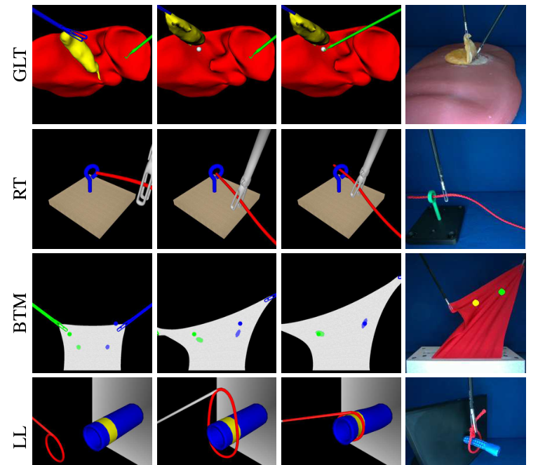
Tasks Used in the Evaluation
Grasp Lift Touch: sequential bimanual coordination.
Rope Threading: navigation through an eyelet.
Bimanual Tissue Manipulation: coordinated deformation.
Ligating Loop: positioning a flexible loop.
Scheikl et al., RA-L 2024
15
Notes:
Figure 2 contains all four task types. Grasp Lift Touch requires one instrument to retract a gallbladder so another can touch a target. Rope Threading requires a flexible rope to pass through an eyelet, which depends on the path rather than simply the final tool location. Bimanual Tissue Manipulation requires concurrent coordination to move tissue markers onto targets. Ligating Loop requires moving a flexible loop around a marked tube. These tasks therefore test different combinations of coordination, deformation, and path constraints. The final column shows the corresponding physical setup for each task.
Sources and figure credits
https://arxiv.org/pdf/2312.10008v2 (Figure 2 and Section IV-A). Figure retained in full.

Slide 16
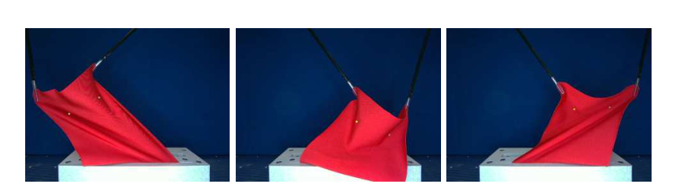
Physical Experiments
xArm7 manipulators use laparoscopic instruments and RGB images.
Cloth and phantoms represent the deformable objects.
The physical Ligating Loop task omits constriction.
Scheikl et al., RA-L 2024
16
Notes:
The physical setup uses xArm7 manipulators, laparoscopic graspers, and an Intel RealSense D405 camera. The objects are deformable substitutes, rather than living tissue. Grasp Lift Touch uses a silicone liver phantom with a latex gallbladder. Bimanual Tissue Manipulation uses cloth. Figure 3 shows how that cloth can fold, bulge, or slacken in ways that differ from the simulated object. The physical Ligating Loop task omits constriction. These are meaningful robot experiments, but the differences matter when deciding what transfers to a surgical procedure. The paper does not establish performance in an animal or human operation.
Sources and figure credits
https://arxiv.org/pdf/2312.10008v2 (Figure 3 and Section IV-A). Figure contains all original cloth examples.

Slide 17
Data and Evaluation Protocol
Task | Simulation demos | Physical demos
Grasp Lift Touch | 90 | 45
Rope Threading | 200 | 45
Bimanual Tissue Manipulation | 150 | 200
Ligating Loop | 135 | 45
One demonstrator. Five simulation seeds. Fifty physical test runs per model.
Scheikl et al., RA-L 2024
17
Notes:
These are the default training-set sizes reported in Section IV-C. One proficient demonstrator collects the trajectories with an Xbox controller at 10 Hz. The simulation protocol uses five random seeds, up to 3,000 training epochs, and evaluation every 100 epochs with 100 task executions. Physical evaluation uses 50 executions of a trained model. The data-efficiency experiment separately varies the training subset size. The paper selects each run’s highest-success epoch when aggregating motion metrics. That selection is useful to know when interpreting the results as a comparison of the methods’ best achieved performance.
Sources and figure credits
https://arxiv.org/pdf/2312.10008v2 (Section IV-C). Default dataset counts and evaluation protocol.

Slide 18
Baselines Used to Evaluate MPD
Method | Diffusion | Network | Motion representation
BESO | Score-based | Transformer | Sequence denoising
DP-T | DDPM | Transformer | Sequence denoising
DP-C | DDPM | Temporal CNN | Sequence denoising
MPD | Score-based | Transformer | ProDMP inside the denoiser
The comparisons change more than one architectural choice.
Scheikl et al., RA-L 2024
18
Notes:
The baseline comparison includes two Diffusion Policy variants and BESO. DP-T uses a transformer, while DP-C uses a temporal convolutional network. Both follow the DDPM formulation. BESO and MPD use the score-based framework, and their main sequence models are transformers. MPD adds its ProDMP decoder. The paper tunes the architectures in preliminary experiments on BTM. Because architecture and diffusion framework also differ across some comparisons, I would not treat every result as a perfectly isolated test of only the primitive decoder. The hardware comparison later contains only MPD and DP-C.
Sources and figure credits
https://arxiv.org/pdf/2312.10008v2 (Sections III-C, III-D and IV-C).

Slide 19
Motion-Quality Metrics
Metric | Meaning in this study
Tissue / marker acceleration | How strongly the manipulated object accelerates
Instrument jerk | How abruptly instrument acceleration changes
Instrument “energy” | An acceleration-sum motion proxy
Path length | Total distance travelled by the instrument
Episode length | Time required to finish the task
These motion metrics complement the task-success rate.
Scheikl et al., RA-L 2024
19
Notes:
The authors use five motion metrics in addition to task success. Tissue acceleration describes the motion of the manipulated object. Instrument jerk is the rate of change of acceleration, so it captures abrupt changes in motion. Their instrument-energy quantity is a sum of accelerations over the execution. It should be understood as a motion proxy, rather than energy in joules. Path length measures total instrument travel, and episode length measures time to task completion. The physical experiments cannot directly observe the full tissue state, so BTM uses marker acceleration as a surrogate. These definitions matter before comparing the bars in Figure 7.
Sources and figure credits
https://arxiv.org/pdf/2312.10008v2 (Section IV-B and Figure 7 caption).

Slide 20
Results with State Observations
Method | GLT | RT | BTM | LL | Average
BESO | 68.4 (6.8) | 90.4 (1.2) | 88.2 (3.9) | 83.2 (4.8) | 82.55
DP-T | 100 (0.0) | 89.6 (1.9) | 98.4 (0.5) | 100 (0.0) | 97.00
DP-C | 100 (0.0) | 82.0 (2.3) | 93.2 (1.9) | 100 (0.0) | 93.80
MPD | 99.2 (0.7) | 93.8 (1.2) | 99.0 (0.6) | 99.6 (0.5) | 97.90
Success (%), mean (SD). MPD leads the average by 0.90 percentage points over DP-T.
Scheikl et al., RA-L 2024
20
Notes:
The entries show mean success percentage and standard deviation across five trained models. The final column is the paper’s four-task average. MPD has the highest average at 97.90 percent, compared with 97.00 for DP-T. MPD is strongest on Rope Threading and BTM here, while DP-T reaches 100 percent on GLT and LL. The average advantage is therefore modest, and it is not a win on every individual task. The table does not supply a significance test on the difference between the cross-task averages. The important next question is whether comparable success comes with better motion quality.
Sources and figure credits
https://arxiv.org/pdf/2312.10008v2 (Table I, State Observations). Native table preserves every reported mean and standard deviation.

Slide 21
Results with Image Observations
Method | GLT | RT | BTM | LL | Average
BESO | 99.8 (0.4) | 66.8 (2.3) | 91.4 (2.4) | 99.8 (0.4) | 89.45
DP-T | 100 (0.0) | 76.6 (4.5) | 95.8 (0.7) | 99.8 (0.4) | 93.05
DP-C | 100 (0.0) | 83.2 (1.2) | 85.2 (1.3) | 100 (0.0) | 92.15
MPD | 100 (0.0) | 78.6 (3.4) | 99.0 (1.1) | 100 (0.0) | 94.40
MPD leads the average, while DP-C performs best on image-based Rope Threading.
Scheikl et al., RA-L 2024
21
Notes:
With image observations, MPD again has the highest four-task average, at 94.40 percent. DP-T reaches 93.05 percent. BTM is a strong result for MPD at 99.0 percent, compared with 95.8 for DP-T and 85.2 for DP-C. Rope Threading is harder for several image-based methods. DP-C actually has the highest rope success here at 83.2 percent, compared with 78.6 for MPD. This is why I would not summarize the paper as one method being best in every situation. The results support a favorable overall combination of performance measures, with visible task-dependent differences.
Sources and figure credits
https://arxiv.org/pdf/2312.10008v2 (Table I, Image Observations). Native table preserves every reported mean and standard deviation.

Slide 22
Results on the Physical Robots
Task / condition | MPD | DP-C
BTM (2 mm threshold, state input) | 90% | 70%
Grasp Lift Touch | 100% | 100%
Rope Threading | 96% | 100%
Ligating Loop (simplified) | 100% | 100%
Fifty executions per evaluated model. Hardware comparison: MPD and DP-C.
Scheikl et al., RA-L 2024
22
Notes:
Only MPD and DP-C run on hardware. The authors explain that DP-T and BESO would require substantial motion postprocessing before physical execution. For the BTM comparison, the 90 versus 70 percent result is specifically the state-input policy at a two-millimeter marker-to-target threshold. Both marker distances must be below that threshold. Each physical evaluation contains 50 executions. GLT and the simplified LL task reach 100 percent for both methods. MPD reaches 96 percent on Rope Threading and DP-C reaches 100 percent. The two failed MPD trials leave the rope bent into an unfamiliar configuration from which the policy cannot recover.
Sources and figure credits
https://arxiv.org/pdf/2312.10008v2 (Section V, Figure 5 and Section IV-A). Native table recreated from reported physical results.

Slide 23
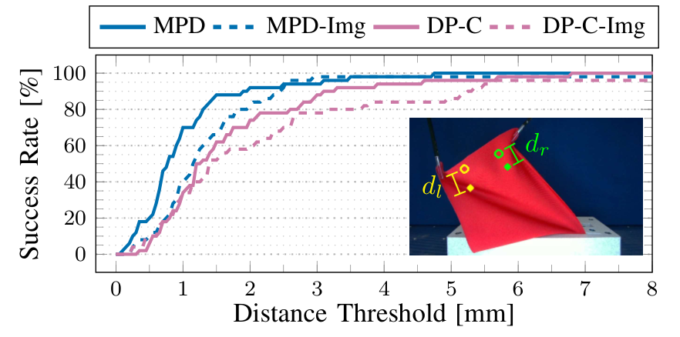
Accuracy Threshold and Task Success
Both marker errors must satisfy the chosen distance threshold.
The reported success rate depends on the required accuracy.
Scheikl et al., RA-L 2024
23
Notes:
Figure 5 makes the physical BTM result more informative than one percentage. The horizontal axis is the allowed marker-to-target error. An episode succeeds only if both marker errors satisfy that threshold. Solid curves use state observations and dashed curves use images. The state-based MPD policy reaches the reported 90 percent success at two millimeters. The plot also shows how the ranking and the practical difference depend on the tolerance. The paper reports that both methods reach 100 percent beyond about 6.5 millimeters. In a surgical application, the acceptable tolerance would have to come from the task requirements.
Sources and figure credits
https://arxiv.org/pdf/2312.10008v2 (Figure 5 and Section V). Complete figure, including legend, axes and marker illustration.

Slide 24
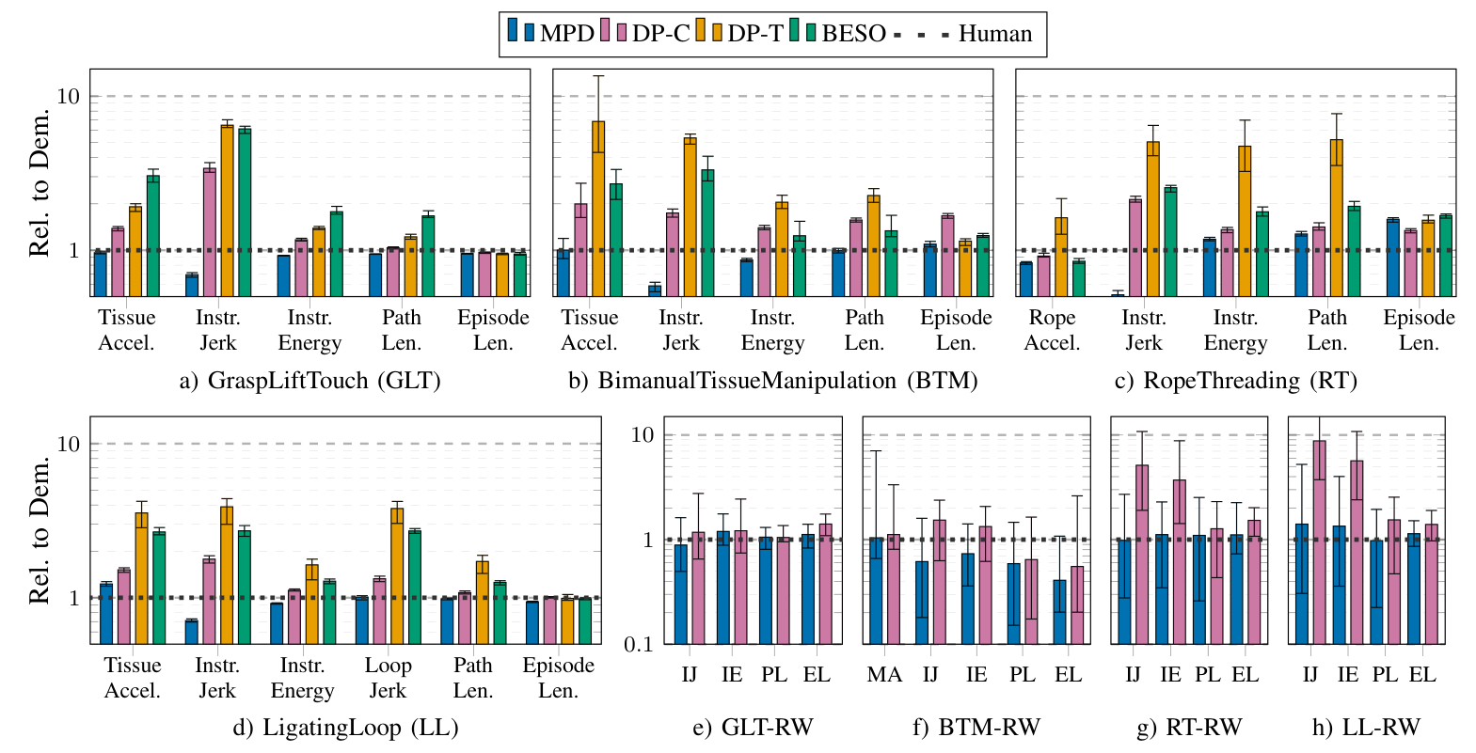
Motion Quality in the Experiments
Human reference = 1. Lower is better. Error bars show minima and maxima.
Scheikl et al., RA-L 2024
24
Notes:
This is the complete Figure 7. MPD is blue, and the dotted human-demonstration reference is one. The vertical axes are logarithmic, so equal vertical distances represent ratios. The paper reports mean values with minimum and maximum error bars. These are not standard deviations. MPD generally has favorable motion values, including low instrument jerk. Some values fall below the demonstrator reference, which means lower values under that specific metric. The physical panels omit direct tissue acceleration, with marker acceleration used for BTM. Lower motion metrics support the gentle-motion claim, but the figure does not directly measure tissue injury or establish a force limit.
Sources and figure credits
https://arxiv.org/pdf/2312.10008v2 (Figure 7, Sections IV-B and V). All panels and the original legend retained.

Slide 25
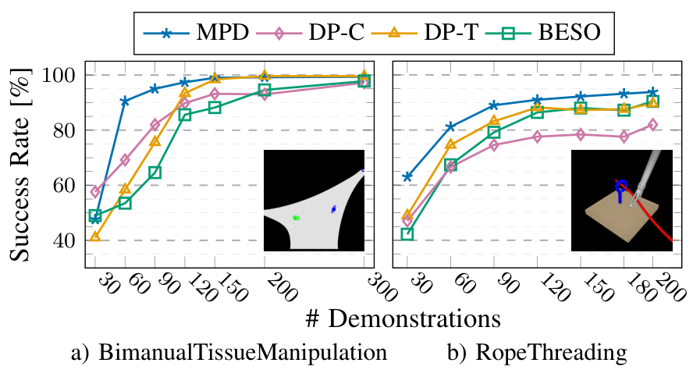
Demonstration Data Efficiency
BTM example: about 90% success with 90 demos for MPD and 120 for DP-T.
Scheikl et al., RA-L 2024
25
Notes:
Figure 6 varies the amount of demonstration data for BTM and Rope Threading with state observations. It is the direct evidence for the data-efficiency claim. On BTM, the authors highlight approximately 90 percent success with 90 demonstrations for MPD. DP-T needs about 120 demonstrations for a similar level in their reported comparison. The benefit is task-dependent, and these curves do not establish a universal number of demonstrations for new surgical tasks. The curves also show that simply adding more data does not guarantee a monotonic improvement for every baseline. Coverage of relevant behaviors and failure states remains important.
Sources and figure credits
https://arxiv.org/pdf/2312.10008v2 (Figure 6, Sections V and VI). Complete two-panel figure with the original legend and axes.

Slide 26
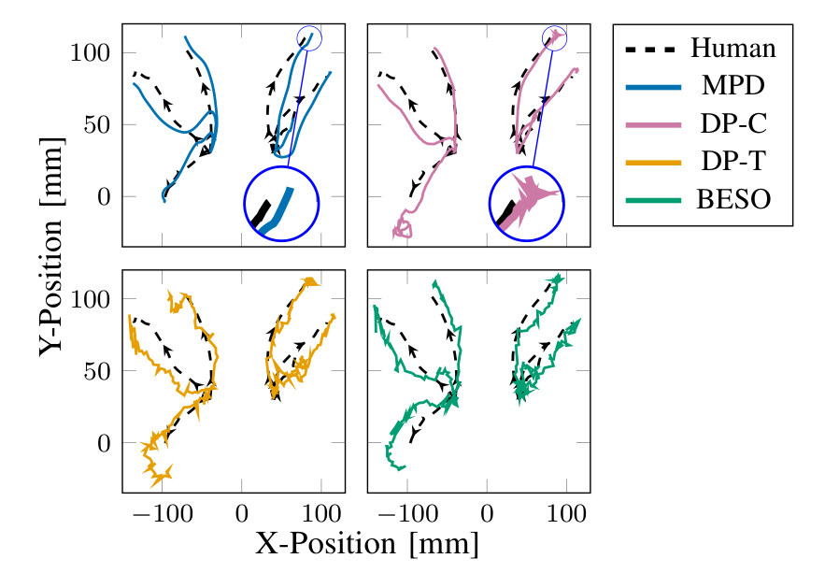
Generated Instrument Trajectories
Path shape makes the motion-quality difference visible.
Scheikl et al., RA-L 2024
26
Notes:
Figure 4 compares instrument paths with the human demonstrations on the simulated BTM task. The black dashed trajectories provide the human reference. Each panel shows one method. The authors use this view to illustrate the irregularity of some baseline action sequences and the smoother MPD output. This is qualitative evidence about path shape. It should be read alongside the quantitative jerk and acceleration metrics. A smooth two-dimensional projection does not by itself establish the full three-dimensional motion quality or contact forces. It does make the practical difference between task success and the character of the generated motion easier to see.
Sources and figure credits
https://arxiv.org/pdf/2312.10008v2 (Figure 4 and Section V). Complete Cartesian trajectory figure, including all four methods and the legend.

Slide 27
Advantages of MPD
Represents different valid demonstrated behaviors.
Sets the initial position and velocity of each motion segment.
Produces high-frequency references from a continuous decoder.
Improves motion metrics on the evaluated tasks.
Learns useful behavior with fewer demonstrations in the reported tests.
Scheikl et al., RA-L 2024
27
Notes:
The strongest advantage is the combination of behavioral flexibility and structured motion. Diffusion can preserve several demonstrated strategies, while the ProDMP supplies a continuous reference with specified initial position and velocity. The decoder also evaluates at a high reference frequency without increasing the length of the denoised sequence to that same rate. The experiments support favorable motion metrics and improved data efficiency on the selected tasks. The method can use state or image observations. The practical claim is therefore broader than a small average success-rate improvement: it is a useful balance of success, motion quality, and the amount of data required.
Sources and figure credits
https://arxiv.org/pdf/2312.10008v2 (Sections III-D, V and VI).

Slide 28
Limitations and Open Problems
Unfamiliar failure states can prevent recovery.
Smooth references do not supply a contact-force guarantee.
Sampling and representation choices add design and computation costs.
The hardware tests compare only MPD and DP-C.
Bench substitutes leave clinical generalization unresolved.
Scheikl et al., RA-L 2024
28
Notes:
The main reported limitation is poor performance outside the demonstration distribution. The bent-rope failure makes this concrete. A smooth trajectory can still create excessive physical interaction, so force limits and tissue safety would need additional evidence or control mechanisms. Diffusion sampling, the network, and the primitive representation introduce computational and design choices. The authors report fast inference for their setup, so this is a tradeoff rather than a claim that MPD is the slowest method. Clinical conclusions are limited by simple bench scenes, deformable substitutes, one demonstrator, and a restricted hardware comparison. The primitive representation can also limit flexibility, which is a modeling tradeoff for further testing.
Sources and figure credits
https://arxiv.org/pdf/2312.10008v2 (Sections IV and VI). Force-safety and representation-flexibility points are presenter interpretation.

Slide 29
Discussion: The Controls Perspective
MPD supplies a learned reference for the physical system.
Tracking control still handles execution and disturbances.
Interaction sensing could help detect a bad plan or contact state.
Supervisory logic could manage replanning and human intervention.
Scheikl et al., RA-L 2024
29
Notes:
From a controls perspective, I would treat MPD as a learned reference generator within a larger system. There is still a physical plant, a state estimate, a tracking controller, and an interaction environment. A good reference does not remove model error or disturbances. This connects to the force-estimation paper: interaction information could become useful for detecting when the planned motion is no longer appropriate. A supervisory layer might pause, request a new plan, or hand control back to a person. Those are possible extensions, not components demonstrated here. The same separation of reference generation, tracking, and monitoring is relevant to CPS and to my future FSW work.
Sources and figure credits
https://arxiv.org/pdf/2312.10008v2 (Sections III and VI). Control architecture, force-estimation, CPS and FSW connections are presenter synthesis.

Slide 30
Five Main Takeaways
Task success and motion quality answer different questions.
Diffusion captures variation. ProDMPs structure the trajectory.
Initial conditions help connect consecutive motion segments.
MPD needs fewer demonstrations in the reported comparisons.
Recovery and clinical safety still require further work.
Scheikl et al., RA-L 2024
30
Notes:
The five points I would retain are these. First, success rate and motion quality need separate evaluation. Second, MPD combines a distribution over behaviors with a structured movement-primitive decoder. Third, initial position and velocity help connect reference segments, while physical tracking remains a control problem. Fourth, the reported experiments show a data-efficiency benefit. Fifth, the evidence concerns simulation and bench manipulation, leaving recovery and clinical safety open. Together, those points explain both why the paper is useful and how far its conclusions should extend.
Sources and figure credits
https://arxiv.org/pdf/2312.10008v2 (synthesis of Sections III–VI).

Slide 31
MPD’s Position in Our Course
Perception papers estimate tissue shape and motion.
Gesture and skill papers represent the surgeon’s behavior.
SUFIA-BC learns actions from demonstrations.
MPD structures the motion produced by a learned policy.
STAR connects task planning with supervised physical execution.
Scheikl et al., RA-L 2024
31
Notes:
The course first gives us ways to represent the surgical scene and estimate what is happening. The gesture and skill papers then examine what the surgeon is doing. Imitation-learning papers such as SUFIA-BC ask how a robot can learn actions from demonstrations. MPD adds structure to the motion those learned actions produce. STAR shows a separate task-level example that combines perception, planning, feedback, and supervision. I would place MPD between learned behavior and physical execution in that narrative. These connections organize the readings; they do not mean the papers implement one combined pipeline. SE(3) remains useful for defining instrument poses and frame transformations, while this paper’s contribution concerns temporal action structure.
Sources and figure credits
Jie Ying Wu, Week 7 lecture slides, slides 10–11, 20 and 49–51.
https://arxiv.org/pdf/2312.10008v2 (Sections III-A and VI). SUFIA-BC, STAR and SE(3) connections reflect the course readings discussed here.

Slide 32
Questions for Discussion
What would we measure before calling the manipulation safe?
Would corrective demonstrations improve the rope-recovery failure?
How should feedback change the motion when tissue moves unexpectedly?
Scheikl et al., RA-L 2024
32
Notes:
These questions are where I would extend the discussion. The first concerns whether the demonstrated motion quality is enough to establish a safe interaction. The second asks how the learning process could include recovery states instead of only successful trajectories. The third asks what feedback should do once the physical object changes in a way the current plan did not anticipate. They connect the paper’s learning result to sensing and supervision. They remain open questions for the group rather than claims that the paper has already solved them.
Sources and figure credits
Presenter questions informed by https://arxiv.org/pdf/2312.10008v2 (Sections V and VI).

Slide 33
Main Paper and Supporting Resources
Movement Primitive Diffusion
Scheikl, P. M., et al. “Movement Primitive Diffusion: Learning Gentle Robotic Manipulation of Deformable Objects.” IEEE Robotics and Automation Letters 9(6), 5338–5345, 2024.
https://doi.org/10.1109/LRA.2024.3382529
Project Page, Code, Data, and Demonstration Video
https://scheiklp.github.io/movement-primitive-diffusion/
Scheikl et al., RA-L 2024
33
Notes:
This presentation focuses on the 2024 Movement Primitive Diffusion paper by Paul Maria Scheikl and colleagues. Its project page provides the associated code, data, and demonstration video. The movement-primitive and diffusion explanations introduce components used by MPD. The original background works are Chi et al., Diffusion Policy, RSS 2023, and Li et al., ProDMP, IEEE RA-L 8(4), 2325–2332, 2023. The course connections are presenter synthesis based on our readings and the Week 7 and Week 5b lecture material.
For the single Neural ODE comparison slide, the supporting background is Chen, Ricky T. Q., et al., Neural Ordinary Differential Equations, Advances in Neural Information Processing Systems 31, 2018. https://papers.neurips.cc/paper_files/paper/2018/hash/69386f6bb1dfed68692a24c8686939b9-Abstract.html. This presentation continues to focus on Scheikl et al.’s MPD method and experiments.
Sources and figure credits
https://arxiv.org/pdf/2312.10008v2
https://doi.org/10.1109/LRA.2024.3382529
https://scheiklp.github.io/movement-primitive-diffusion/
Method background cited by MPD: Chi et al., Diffusion Policy, RSS 2023. Li et al., ProDMP, IEEE RA-L 8(4), 2325–2332, 2023.

